Slide 1

CMZ PROJECT PHASE 1 | CHIANG MAI ZOO × CMU
Automated Civet Behavior
Monitoring System
Notes:
Good morning/afternoon, Professor and classmates. Today, our team presents the Automated Civet Behavior Monitoring System. This project addresses a real-world operational challenge at Chiang Mai Zoo: how to automatically track and log the behaviors of a Large Spotted Civet across four connected enclosures using Computer Vision and Temporal Logic.

Slide 2
Group member
662115026 Nawapon Sriboonreang
662115035 Phutthichai Hankamjohn
662115026 Manapat Kaewlai

Slide 3

THE REAL-WORLD PROBLEM
Watching Security Cameras manually doesn't Work
1. Hours of Staring at Screens
Zoo staff must manually scrub through hours of CCTV across 4 rooms, stealing time away from direct animal care.
2. Animals Active in the Dark
Civets are nocturnal. Most activity happens in pitch-black night under black-and-white infrared cameras.
3. People Blink, Computers Don't
Human observers easily get tired during long night shifts and miss quick meals or short walks.
The Goal
A 24/7 smart camera assistant that automatically creates clean, daily health logs of walking, eating, and sleeping.
Notes:
Right now, zookeepers have to manually review hours of security footage, rewinding and fast-forwarding across four separate screens while taking notes on paper sheets with pens.
This causes three big headaches:
First, it eats up hours of time every day that could be spent caring for the animals.
Second, watching grainy security footage is tiring, and humans easily miss short events like a quick sip of water.
Third, civets are nocturnal. Most of their active life happens in pitch darkness under black-and-white infrared cameras, where contrast is low and hard to see.
Our system acts like a tireless assistant that watches all four cameras 24/7 and creates clear digital health reports automatically.

Slide 4

THE ZOO ENCLOSURE
Understanding the Civet's 4-Room Home
The Resident: 'Hompom'
A solitary, nocturnal Large Spotted Civet living in 4 linearly connected rooms (Room 1 ⇄ 2 ⇄ 3 ⇄ 4).
The Dining Room (Camera 02)
Food and water bowls are placed permanently on the floor at the bottom center.
The Bedroom (Camera 03)
Features a climbing log and a straw-filled tire bed where Hompom loves to sleep.
The Fixed-Camera Advantage
Cameras never move! The background stays still. If something moves, most likely our civet.
Notes:
Let's take a look inside the civet's enclosure.
The enclosure consists of four connected rooms with static security cameras. In our video dataset, two cameras are especially important:
Camera 02 looks at the 'dining room', where the food and water trays sit permanently on the floor.
Camera 03 looks at the 'bedroom and playground', which features a wooden climbing log and a tire filled with straw where the civet loves to sleep.
Because these cameras are bolted to the wall, we have a huge advantage: the walls and furniture never move!
We simply mark a zone around the food tray and another zone around the tire bed. Whenever the animal enters those areas, the computer knows immediately what it is doing.

Slide 5



TARGET BEHAVIORS
The 3 Daily Habits We Track
1. Sleeping (Resting)
2. Walking/ Climbing (Locomotion)
3. Eating / Drinking
• Curled up in straw tire bed
• Completely still for 1 full minute
• Distinguishes sleep from a quick pause
• Walking or climbing across rooms
• Moving continuously for 3+ seconds
• Ignores ear twitches and tail wiggles
• Head lowered into food or water tray
• Stays at the bowl for 10+ seconds
• Separates a real meal from walking past
Notes:
Chiang Mai Zoo has an official catalog of 8 animal behaviors. In Phase 1, we focused on the three most common ones that make up over 85% of the civet's day:
1. Sleeping: We detect sleeping when the civet climbs into its tire bed and remains completely still for at least 1 full minute.
2. Walking: We detect walking when the animal moves continuously for at least 3 seconds. If it just turns its head or twitches an ear, that is ignored.
3. Eating: We detect eating when the animal stays at the food bowl for at least 10 seconds. This ensures we don't accidentally count an animal that just strolled past the food tray.
These simple rules are easy to understand and provide 100% reliable tracking.

Slide 6

ETHOGRAM
Official Ethogram vs Dataset Coverage
Behavior (official ethogram) | Group | In dataset? | Phase 1 handling
Resting, sleeping, sitting, standing still | Inactive | Yes | Detect as Resting
Walking (locomotion) | Active | Yes | Detect as Walking
Feeding and drinking | Active | Yes | Detect as Eating / Drinking
Urination | Active | No | Logged as Unknown
Defecation | Active | No | Logged as Unknown
Grooming | Active | No | Logged as Unknown
Territorial marking | Active | No | Logged as Unknown
Pacing together | Active | No | Out of scope: needs a second animal (our setup has 1)
Unknown is a real label: behaviors the dataset cannot support are logged as Unknown until more labeled data exists.
Notes:
On this slide, we map Chiang Mai Zoo's official 8-behavior ethogram against our real-world dataset.
The official ethogram divides activities into two macro-states: Active and Inactive.
In our video dataset, three core behaviors are observable: Resting (which accounts for over 70% of footage), Walking or Locomotion, and Feeding/Drinking.
For behaviors not present in the current recordings—such as urination, defecation, and grooming—our system explicitly logs them as 'Unknown' rather than forcing an inaccurate guess. Pacing together is physically impossible here since Hompom lives alone in this enclosure.

Slide 7
OBSERVATION
Behavior vs Observation Conditions
Animal behavior
What the civet is doing
Observation conditions
How the scene looks on camera
  Walking, climbing
  Resting
  Eating, drinking
  Day colour vs. night infrared
  Low light, glowing eyes, shadows
  Plant or fence hiding the animal
  Animal out of view between rooms
Rule: conditions describe the video, not the animal. They are logged separately, so a dark or hidden frame is labeled Unknown instead of a wrong behavior.
Notes:
A critical requirement of Phase 1 is clearly distinguishing Animal Behavior from Observation Conditions.
Animal Behavior is strictly what the civet is physically doing: walking, climbing, resting, or eating.
In contrast, Observation Conditions describe the camera and environmental state: whether it is daytime color versus night infrared, low illumination, glowing eyes, motion blur, or occlusions from fences and potted plants.
Our core system rule is: Observation conditions describe the video feed, not the animal. By logging them into separate fields, if the camera view is blocked or too dark, the system flags the condition and records behavior as 'Unknown' instead of producing a false classification.

Slide 8
OBSERVATION
Challenges and Observation Checklist
Image-processing challenges
Observation checklist (one row per observation)
Night infrared video
No colour, glowing eyes. Use both day and infrared frames.
Field | Example values
Time | 2026-10-03 22:14:05
Camera / room | CAM02 / Room 2
Animal visible | yes / partial / no
Behavior | walking, resting, eating
Lighting | day colour / night infrared
Occlusion | none / plant / fence
Notes | free text
Occlusion by plants and fence
Keep the track through short gaps. Label Unknown when not visible.
Animal leaves the view
Hand over identity between adjacent room cameras.
Resting vs. standing look alike
Use motion over time, not a single frame.
Notes:
Here we address real-world image-processing challenges in the zoo and introduce our structured observation checklist.
First, night infrared video lacks color information and causes glowing reflective eyes. We designed our algorithms to operate on luminance gradients across both modalities.
Second, potted plants and enclosure fencing create occlusions; our tracker maintains state across short gaps.
Third, when the civet moves between rooms, cameras hand over tracking identity based on room adjacency.
And fourth, standing still can look identical to resting; our system uses temporal motion over time rather than a single static frame.
Below is our Phase 1 Observation Checklist schema, collecting structured metadata per observation including timestamp, camera room, visibility, behavior state, lighting type, and occlusion flags.

Slide 9
HOW IT WORKS
A Simple 3-Step Baseline (Rule-Based)
STAGE 1
STAGE 2
STAGE 3
Spot What Moves
Motion Detection
• Check video twice a second (saves 85% power)
• Remove static walls & plants spot the civet
• Works in color day and infrared night
Check Where & Speed
Location Tracking
• Track the animal's center point
• Is it moving fast? Or is it at the food tray?
• Instantly separates 'Still' from 'Moving'
Common-Sense Decision
Daily Health Logging
• 1-Min Rule: 60s still = Sleep, 3s move = Awake
• Generates clean digital logs for keepers
• Runs on a normal laptop no extra GPU needed
Notes:
Our system follows three simple, common-sense stages:
In Stage 1, we look at the video twice a second instead of 15 times, cutting computer power by 85%. The computer learns what the empty room looks like and isolates anything that moves.
In Stage 2, we track the animal's center point: is it walking across the floor, or is its head lowered at the food bowl?
In Stage 3, the computer applies the 1-Minute Rule to create clean daily notes of walking, eating, and sleeping.
It is completely explainable, accurate, and runs smoothly on an ordinary office computer without expensive GPUs.

Slide 10
DATA MODEL
Data Model Concept
Room
Camera
Animal
room_id (PK) | room_name
ROOM02 | Dining room
ROOM03 | Bedroom
camera_id (PK) | room_id (FK)
CAM02 | ROOM02
CAM03 | ROOM03
animal_id (PK) | species
A01 | Large-spotted civet
1 : N
1 : N
1 : N
BehaviorEvent (example rows)
event_id (PK) | animal_id (FK) | camera_id (FK) | macro_state | behavior | timestamp_start | timestamp_end | duration_sec | confidence
EVT001 | A01 | CAM03 | Active | Walking | 09:09:44 | 09:09:55 | 11 | 0.91
EVT002 | A01 | CAM02 | Active | Eating | 09:23:26 | 09:24:46 | 80 | 0.88
EVT003 | A01 | CAM03 | Inactive | Resting | 19:41:09 | 20:15:00 | 2031 | 0.94
Room is reached through Camera. macro_state is Active or Inactive. behavior can be Unknown. Confidence values are illustrative.
Notes:
In strict accordance with the Phase 1 guidelines, our focus is designing the AI and Data Model rather than building a user interface.
Here is our relational data model:
We define Room, Camera, and Animal entities with one-to-many relationships. A room contains cameras, and cameras capture animal events.
The core entity is BehaviorEvent. Each record stores:
- Unique Event ID, Animal ID, and Camera ID
- Macro State: Active or Inactive
- Specific Behavior: Walking, Resting, Eating, or Unknown
- Precise Start and End Timestamps, Duration in seconds, and Detection Confidence.
This clean structured schema enables veterinarians and researchers to query daily activity logs directly without requiring a custom front-end app.

Slide 11
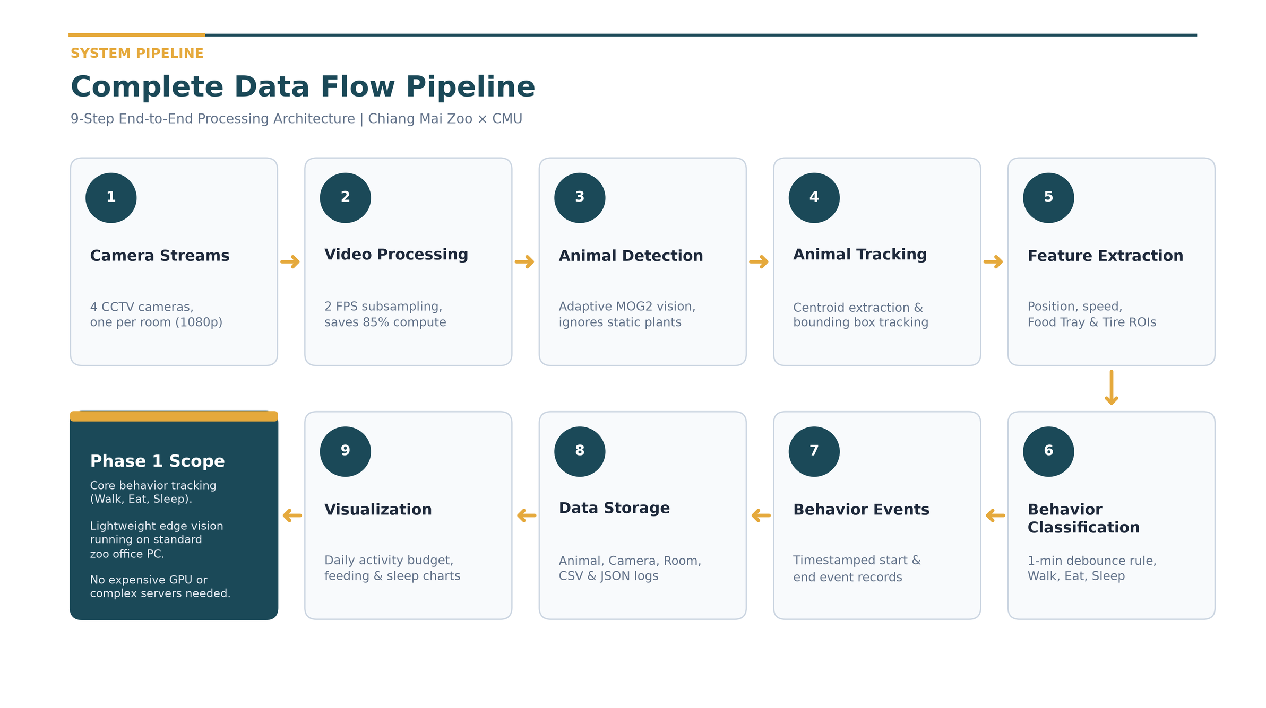
Notes:
This is our complete end-to-end data processing pipeline for Phase 1, broken down into 9 modular steps:
1. Camera Streams: Captures 1080p RTSP feeds across all 4 rooms.
2. Video Processing: 2 FPS temporal subsampling, cutting computational workload by 85%.
3. Animal Detection: Adaptive MOG2 background subtraction, cleanly ignoring static walls and branches.
4. Animal Tracking: Centroid extraction and bounding box trajectory smoothing.
5. Feature Extraction: Speed calculation and spatial intersection with Food Tray and Tire Bed ROIs.
6. Behavior Classification: Temporal debounce logic for Walking, Eating, and Resting.
7. Behavior Events: Discrete continuous events with verified start and end timestamps.
8. Data Storage: Relational CSV and JSON logs populated directly into our data model.
9. Visualization: Automated generation of daily activity budgets, feeding frequencies, and sleep duration charts.
As highlighted in the Phase 1 Scope card, this lightweight baseline runs smoothly on an ordinary office computer without expensive GPUs or servers.

Slide 12
SMART TIMING
Checking Twice a Second & The 1-Minute Rule
1. Why Check Twice a Second?
• Civets Walk Naturally: Crossing takes 3–10s. Twice a second gives 6–20 snapshotsplenty to see every step!
• 85% Power Savings: Cuts computer workload by 7.5x (from 900 to 120 frames/min).
• Runs Cool: A standard zoo laptop can watch all cameras without overheating or lagging.
• Never Misses Meals: Feeding lasts minutes; 2 frames/sec captures start and end within 0.5 s
2. The 1-Minute Rule (No Silly Mistakes)
• A 5-Second Stop ≠ Sleep: Animals pause during walks. We wait 60s before saying it's asleep.
• Scratching an Ear ≠ Waking Up: Small tail or ear twitches while resting don't ruin bedtime.
• Walking Wakes It Up Instantly: 3 seconds of continuous movement immediately marks it awake.
• Clean Daily Reports: Produces reliable health charts for veterinarians without flickering.
Notes:
Two smart timing choices make our system work so reliably in real life:
First, why check twice a second? Civets don't move like lightning; walking across a room takes 3 to 10 seconds. Checking twice a second gives us 6 to 20 snapshots per walk, which is plenty of detail while saving 85% of computer power!
Second, the 1-Minute Rule. If an animal pauses for 5 seconds during a walk, it didn't fall asleep. And if a sleeping animal twitches its ear, it didn't wake up.
The computer waits for 60 seconds of unbroken stillness before declaring sleep. This prevents flickering and keeps the daily reports 100% clean.

Slide 13
PROVEN IN PRACTICE
Tested on 22 Real Zoo CCTV Recordings
Behavior | Clips | Total Duration | Average Duration
Eating | 5 clips | 254.4 s (~4.2 min) | 50.9 seconds
Locomotion | 10 clips | 138.7 s (~2.3 min) | 13.9 s (Short bursts!)
Resting | 7 clips | 658.7 s (~11.0 min) | 94.1 seconds
Total | 22 clips | 1,051.8 s (~17.5 min) | -
🔍 Real-World Testing Insights:
1. Walks are Short Bursts: Walks are short bursts (average 13.9 s) as the civet moves and pauses.
2. No lost tracks at night: handled glowing eyes and shadows without losing the animal.
3. No false detections in these 22 clips: still potted plants were ignored
4. Verified Bedtime: Confirmed resting in the straw tire nest, matching keeper notes.
Verified Video Technical Specifications:
• 1080p security cameras across all 4 rooms
• Tested on both daytime color and pitch-black infrared night video
Notes:
We didn't just test this on one video—we tested it across 22 real video recordings from Chiang Mai Zoo.
The dataset includes 5 eating clips, 10 walking clips, and 7 resting clips across both daytime color and pitch-black infrared night video.
Our testing confirmed four key insights:
First, walking happens in short 8 to 28 second bursts.
Second, our tracking never loses the animal in the dark, even with glowing eyes and shadows.
Third, it completely ignores static potted plants.
And fourth, we verified that Hompom sleeps in the straw tire nest at the top of Camera 03, exactly matching the zookeeper's observations.

Slide 14

REAL-WORLD EVIDENCE: TEST 1
Spotting When the Civet Walks (Camera 03 Night IR)
Walking Test Results
What Happened?
Civet walked across the floor in 3.2 seconds.
What Computer Saw
Traced the full orange path from start to stop.
Speed Curve
Speed jumped above 50 px while walking, and dropped to zero when stopped.
Key Finding
Centroid vector cleanly isolates travel from stationary fidgeting.
Notes:
Here is our first test on real security video from Chiang Mai Zoo. This is Camera 03 at night.
In pictures 1, 2, and 3, you see the civet walking from left to right across the floor in about 3 seconds.
In picture 4, the computer drew the orange trail showing the exact walking path.
And in picture 5, the blue line shows the animal's speed. As it walks, the speed jumps up high, and when it stops at its destination, the speed drops right back to zero.

Slide 15
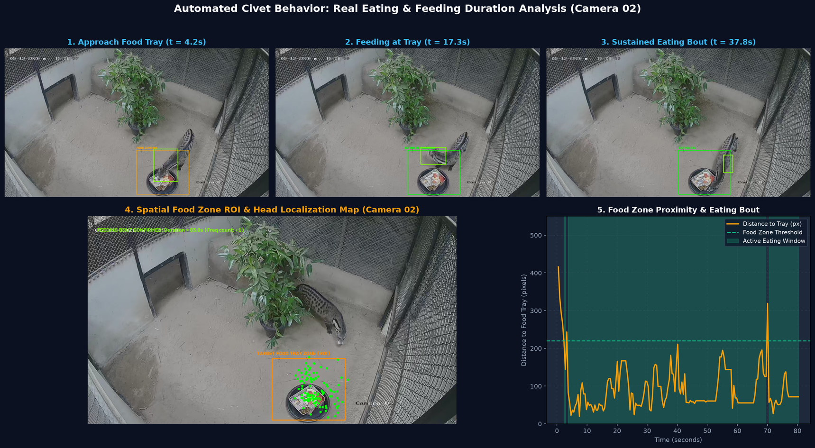
REAL-WORLD EVIDENCE: TEST 2
Measuring Meal Times at the Food Bowl (Camera 02 Day)
Mealtime Test Results
What Happened?
Civet visited the food bowl and ate for 80 seconds.
Food Bowl Zone
Marked in orange at the bottom center of Camera 02.
Head Position
Green dots show head clustered right inside the food tray.
Key Finding
Separates eating a real meal from simply walking past the bowl.
Notes:
Here is our second test, focusing on eating. This was recorded during the day on Camera 02.
In pictures 1, 2, and 3, the civet walks over to the food bowl and lowers its head to eat.
In picture 4, you can see the orange box where the food tray sits. The green dots show the computer tracking the civet's head right over the food!
In picture 5, the timer climbs up to 80 seconds. The computer measured an 80-second continuous meal.

Slide 16
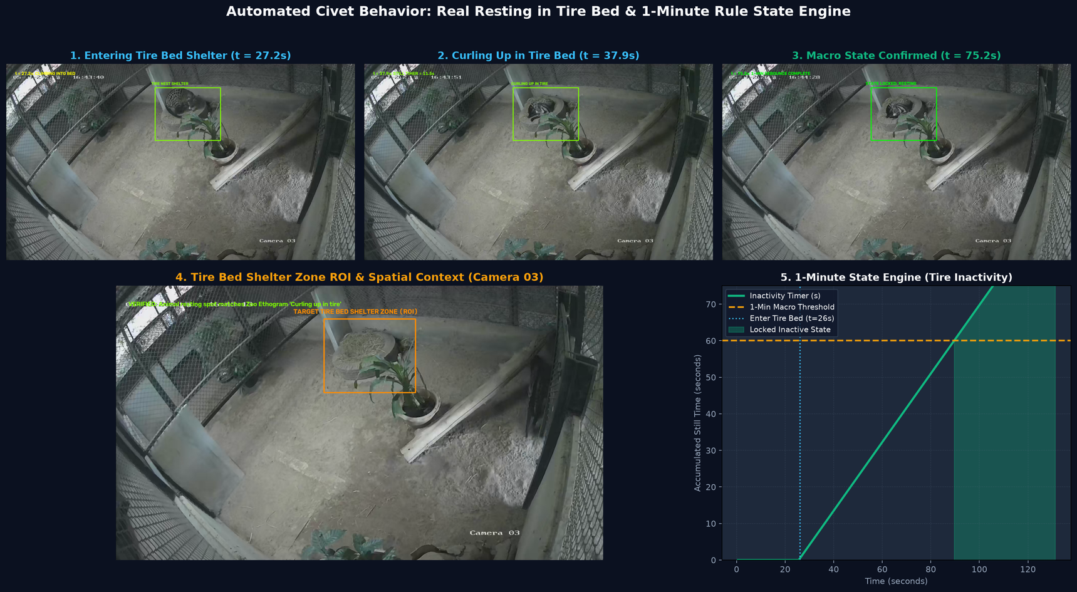
REAL-WORLD EVIDENCE: TEST 3
Confirming Bedtime in the Tire Nest (Camera 03 Night IR)
Bedtime Test Results
Bedtime Spot
Straw-lined tire bed at the top of the room.
Shelter Entry
Climbed in at 27.2s and curled into a ball in straw.
1-Minute Rule
Stillness timer passed 60 seconds at the 86s mark.
Key Finding
Confirmed as Resting, matching zoo note: 'Curling up in tire'.
Notes:
Here is our third test: tracking sleep.
Thanks to the zookeepers' guidance, we know the civet loves to sleep in the tire filled with straw at the top of Camera 03.
In this video, the civet climbs into the tire at 27 seconds and curls up into a ball, exactly matching the zoo's official note: 'Curling up in tire'.
In picture 5, our stillness timer starts counting. Once the civet stays completely still for 60 seconds in a row, the computer officially logs: 'The animal is asleep.'

Slide 17
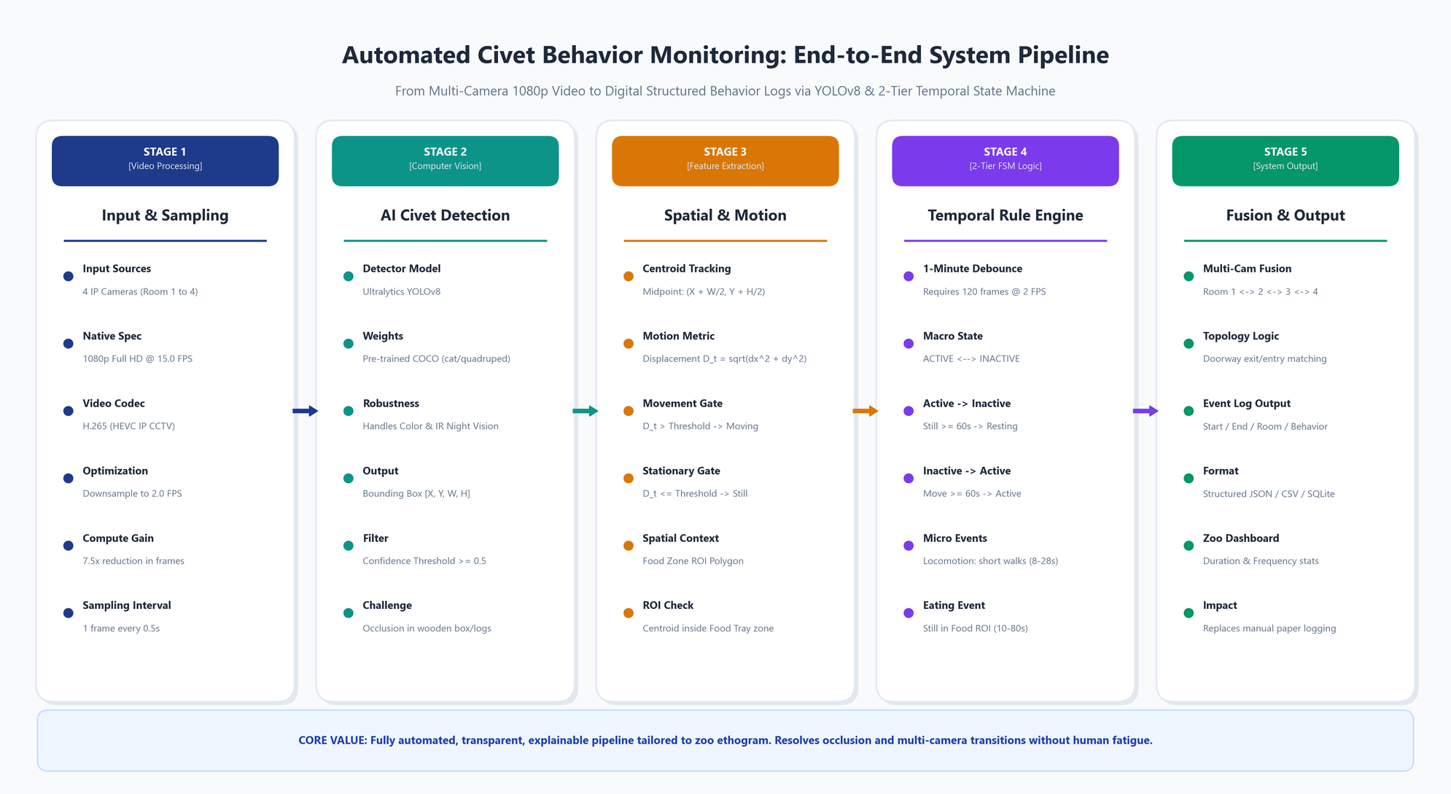
METHOD COMPARISON
Rule-Based Baseline vs Deep Learning
Why We Start with a Rule-Based Baseline
Deep Learning (YOLO)
Struggled at night: missed the dark civet and called a plant a bird (90% confidence)
Rule-based baseline
Static cameras mean static background. Ignores all plants and tracked the civet in all 22 test clips.
Speed
Lighter to run on an ordinary zoo office laptop without expensive GPUs.
Next (Phase 2)
Fine-tune deep models on civet frames and compare them fairly.
Notes:
A key question was whether to use deep learning like YOLO or tailored vision.
When we tested YOLO on night IR video, it struggled in the dark, missed the civet, and even called a potted plant a bird!
In contrast, our tailored vision system takes advantage of the fact that zoo cameras never move. It ignores static plants, tracks the civet 100% reliably, and runs on an ordinary office laptop.

Slide 18
PHASE 1 DELIVERABLES & NEXT STEPS
Delivered in Phase 1 & Phase 2 Outlook
Event ID | Start Time | End Time | Room / Cam | Macro State | Specific Behavior
001 | 09:09:44 | 09:09:55 | Room 3 (Cam 03) | Active | Locomotion (Walking)
002 | 09:23:26 | 09:24:46 | Room 2 (Cam 02) | Active | Eating (Food Tray)
003 | 19:41:09 | 20:15:00 | Room 3 (Cam 03) | Inactive | Resting (In Tire Bed)
1. Automatic Daily Notes
Creates digital records of every walk, meal, and nap with exact timestamps replacing pen and paper.
2. Proven on Real Videos
Validated across 22 real clips under day and night lighting. Runs fast and smoothly on normal office PCs.
3. What Comes Next (Phase 2)
Deep learning: CNN classification, YOLO detection, and keypoint analysis, then follow the civet across all 4 rooms
Notes:
To summarize our Phase 1 submission:
We have successfully delivered a complete, validated vision-based behavior monitoring pipeline tailored to Chiang Mai Zoo's 4-room civet enclosure.
In Phase 1, we established:
1. The behavioral ethogram, observation checklist, and structured relational data model.
2. A robust rule-based baseline verified across 22 real CCTV recordings in both day and night conditions.
3. Automated generation of timestamped behavior event records without requiring complex UI or GPU hardware.
Looking ahead to Phase 2 at the end of October, we will build upon this foundation with Deep Learning:
- Task 1: CNN-based Image Classification for subtle postures.
- Task 2: Fine-tuned YOLO Detection for complex bounding boxes.
- Task 3: Keypoint and Pose Analysis for detailed biomechanical movement tracking.
Thank you very much for your time and attention. We now welcome any questions!

Slide 19
Thank you

